Slide 1

ITS30705 CHAPTER 10: searching and sorting

Slide 2
Searching
Sequential Search
Binary Search

Slide 3
Sequential search
sequential search: Locates a target value in a list by examining each element from start to finish. Used in index.
How many elements will it need to examine?
Example: Searching the list below for the value 42:
index | 0 | 1 | 2 | 3 | 4 | 5 | 6 | 7 | 8 | 9 | 10 | 11 | 12 | 13 | 14 | 15 | 16
value | -4 | 2 | 7 | 10 | 15 | 20 | 22 | 25 | 30 | 36 | 42 | 50 | 56 | 68 | 85 | 92 | 103
i

Slide 4
Sequential search
How many elements will be checked?
On average how many elements will be checked?
def index(value):
for i in range(0, size):
if my_list[i] == value:
return i
return -1 # not found
index | 0 | 1 | 2 | 3 | 4 | 5 | 6 | 7 | 8 | 9 | 10 | 11 | 12 | 13 | 14 | 15 | 16
value | -4 | 2 | 7 | 10 | 15 | 20 | 22 | 25 | 30 | 36 | 42 | 50 | 56 | 68 | 85 | 92 | 103

Slide 5
Binary search
binary search: Locates a target value in a sorted list by successively eliminating half of the list from consideration.
How many elements will it need to examine?
Example: Searching the list below for the value 42:
index | 0 | 1 | 2 | 3 | 4 | 5 | 6 | 7 | 8 | 9 | 10 | 11 | 12 | 13 | 14 | 15 | 16
value | -4 | 2 | 7 | 10 | 15 | 20 | 22 | 25 | 30 | 36 | 42 | 50 | 56 | 68 | 85 | 92 | 103
min
mid
max

Slide 6
Binary search runtime
For an list of size N, it eliminates ½ until 1 element remains.
N, N/2, N/4, N/8, ..., 4, 2, 1
How many divisions does it take?
Think of it from the other direction:
How many times do I have to multiply by 2 to reach N?
1, 2, 4, 8, ..., N/4, N/2, N
Call this number of multiplications "x".
2^{x} = N
x = log₂ N
Binary search looks at a logarithmic number of elements

Slide 7
binary_search
Write the following two functions:
# searches an entire sorted list for a given value
# returns the index the value should be inserted at to maintain sorted order
# Precondition: list is sorted
binary_search(list, value)
# searches given portion of a sorted list for a given value
# examines min_index (inclusive) through max_index (exclusive)
# returns the index of the value or -(index it should be inserted at + 1)
# Precondition: list is sorted
binary_search(list, value, min_index, max_index)

Slide 8
Using binary_search
# index 0 1 2 3 4 5 6 7 8 9 10 11 12 13 14 15
a = [-4, 2, 7, 9, 15, 19, 25, 28, 30, 36, 42, 50, 56, 68, 85, 92]
index1 = binary_search(a, 42)
index2 = binary_search(a, 21)
index3 = binary_search(a, 17, 0, 16)
index2 = binary_search(a, 42, 0, 10)
binary_search returns the index of the number
or
(index where the value should be inserted + 1)

Slide 9
Binary search code
# Returns the index of an occurrence of target in a,
# or a negative number if the target is not found.
# Precondition: elements of a are in sorted order
def binary_search(a, target, start, stop):
min = start
max = stop - 1
while min <= max:
mid = (min + max) // 2
if a[mid] < target:
min = mid + 1
elif a[mid] > target:
max = mid - 1
else:
return mid # target found
return -(min + 1) # target not found

Slide 10
Sorting

Slide 11
Sorting
sorting: Rearranging the values in a list into a specific order (usually into their "natural ordering").
one of the fundamental problems in computer science
can be solved in many ways:
there are many sorting algorithms
some are faster/slower than others
some use more/less memory than others
some work better with specific kinds of data
some can utilize multiple computers / processors, ...
comparison-based sorting : determining order by comparing pairs of elements:
<, >, …

Slide 12
Sorting algorithms
bogo sort: shuffle and pray
bubble sort: swap adjacent pairs that are out of order
selection sort: look for the smallest element, move to front
insertion sort: build an increasingly large sorted front portion
merge sort: recursively divide the list in half and sort it
heap sort: place the values into a sorted tree structure
quick sort: recursively partition list based on a middle value other specialized sorting algorithms:
bucket sort: cluster elements into smaller groups, sort them
radix sort: sort integers by last digit, then 2nd to last, then ...
etc

Slide 13
Selection sort
selection sort: Orders a list of values by repeatedly putting the smallest or largest unplaced value into its final position.
The algorithm:
Look through the list to find the smallest value.
Swap it so that it is at index 0.
Look through the list to find the second-smallest value.
Swap it so that it is at index 1.
...
Repeat until all values are in their proper places.

Slide 14
Selection sort example
Initial list:
After 1st, 2nd, and 3rd passes:
index | 0 | 1 | 2 | 3 | 4 | 5 | 6 | 7 | 8 | 9 | 10 | 11 | 12 | 13 | 14 | 15 | 16
value | 22 | 18 | 12 | -4 | 27 | 30 | 36 | 50 | 7 | 68 | 91 | 56 | 2 | 85 | 42 | 98 | 25
index | 0 | 1 | 2 | 3 | 4 | 5 | 6 | 7 | 8 | 9 | 10 | 11 | 12 | 13 | 14 | 15 | 16
value | -4 | 18 | 12 | 22 | 27 | 30 | 36 | 50 | 7 | 68 | 91 | 56 | 2 | 85 | 42 | 98 | 25
index | 0 | 1 | 2 | 3 | 4 | 5 | 6 | 7 | 8 | 9 | 10 | 11 | 12 | 13 | 14 | 15 | 16
value | -4 | 2 | 12 | 22 | 27 | 30 | 36 | 50 | 7 | 68 | 91 | 56 | 18 | 85 | 42 | 98 | 25
index | 0 | 1 | 2 | 3 | 4 | 5 | 6 | 7 | 8 | 9 | 10 | 11 | 12 | 13 | 14 | 15 | 16
value | -4 | 2 | 7 | 22 | 27 | 30 | 36 | 50 | 12 | 68 | 91 | 56 | 18 | 85 | 42 | 98 | 25

Slide 15
Selection sort code
# Rearranges the elements of a into sorted order using
# the selection sort algorithm.
def selection_sort(a):
for i in range(0, len(a) - 1):
# find index of smallest remaining value
min = i
for j in range(i + 1, len(a)):
if (a[j] < a[min]):
min = j
# swap smallest value its proper place, a[i]
swap(a, i, min)

Slide 16
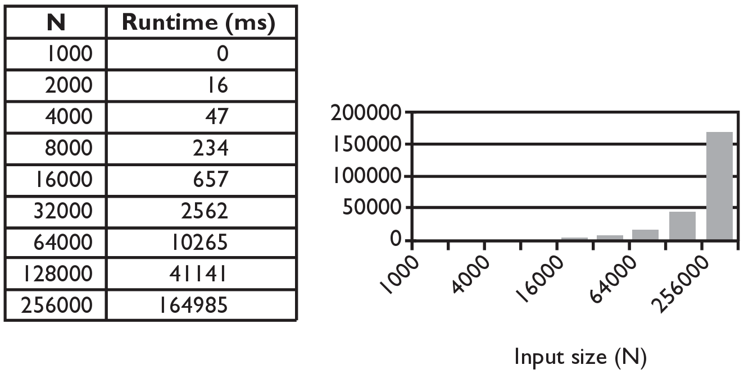
Selection sort runtime (Fig. 13.6)
How many comparisons does selection sort have to do?

Slide 17
Similar algorithms
bubble sort: Make repeated passes, swapping adjacent values
slower than selection sort (has to do more swaps)
insertion sort: Shift each element into a sorted sub-list
faster than selection sort (examines fewer values)
index | 0 | 1 | 2 | 3 | 4 | 5 | 6 | 7 | 8 | 9 | 10 | 11 | 12 | 13 | 14 | 15 | 16
value | 22 | 18 | 12 | -4 | 27 | 30 | 36 | 50 | 7 | 68 | 91 | 56 | 2 | 85 | 42 | 98 | 25
index | 0 | 1 | 2 | 3 | 4 | 5 | 6 | 7 | 8 | 9 | 10 | 11 | 12 | 13 | 14 | 15 | 16
value | 18 | 12 | -4 | 22 | 27 | 30 | 36 | 7 | 50 | 68 | 56 | 2 | 85 | 42 | 91 | 25 | 98
22
50
91
98
index | 0 | 1 | 2 | 3 | 4 | 5 | 6 | 7 | 8 | 9 | 10 | 11 | 12 | 13 | 14 | 15 | 16
value | -4 | 12 | 18 | 22 | 27 | 30 | 36 | 50 | 7 | 68 | 91 | 56 | 2 | 85 | 42 | 98 | 25
sorted sub-list (indexes 0-7)
7

Slide 18
Merge sort
merge sort: Repeatedly divides the data in half, sorts each half, and combines the sorted halves into a sorted whole.
The algorithm:
Divide the list into two roughly equal halves.
Sort the left half.
Sort the right half.
Merge the two sorted halves into one sorted list.
Often implemented recursively.
An example of a "divide and conquer" algorithm.
Invented by John von Neumann in 1945

Slide 19
Merge sort example
index | 0 | 1 | 2 | 3 | 4 | 5 | 6 | 7
value | 22 | 18 | 12 | -4 | 58 | 7 | 31 | 42
split
22 | 18 | 12 | -4
58 | 7 | 31 | 42
split
split
22 | 18
12 | -4
58 | 7
31 | 42
split
split
split
split
22
18
12
-4
58
7
31
42
merge
merge
merge
merge
18 | 22
-4 | 12
7 | 58
31 | 42
merge
merge
-4 | 12 | 18 | 22
7 | 31 | 42 | 58
merge
-4 | 7 | 12 | 18 | 22 | 31 | 42 | 58

Slide 20
Merge halves code
# Merges the left/right elements into a sorted result.
# Precondition: left/right are sorted
def merge(result, left, right):
i1 = 0 # index into left list
i2 = 0 # index into right list
for i in range(0, len(result)):
if i2 >= len(right) or (i1 < len(left) and left[i1] <= right[i2]):
result[i] = left[i1] # take from left
i1 += 1
else:
result[i] = right[i2] # take from right
i2 += 1

Slide 21
Merge sort code
# Rearranges the elements of a into sorted order using
# the merge sort algorithm.
def merge_sort(a):
if len(a) >= 2:
# split list into two halves
left = a[0, len(a)//2]
right = a[len(a)//2, len(a)]
# sort the two halves
merge_sort(left)
merge_sort(right)
# merge the sorted halves into a sorted whole
merge(a, left, right)

Slide 22
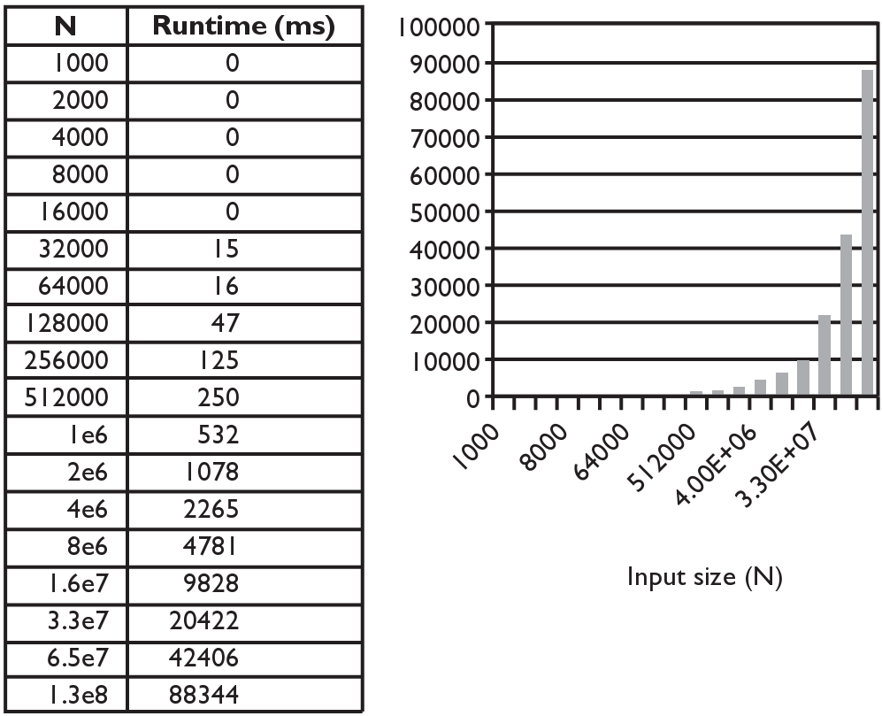
Merge sort runtime
How many comparisons does merge sort have to do?

